Slide 1
iNetBanking
(banking application)
Guided by- Mr.Sanjit Jha
Developed by
Abhinandan B
Gopinath S
Poorna Chandra P
Rishabh Tiwari
Faayiz Khan

Slide 2
Contents
Introduction
Architecture
Tools and technology
Database
Home page
Register and login
Future scope
Conclusion

Slide 3
Introduction
“iNetBanking” is a an application for making all the bank operations online
This application allows all the users to perform their transactions in a simple and secure way
This application is used for hassle free user login and registration

Slide 4
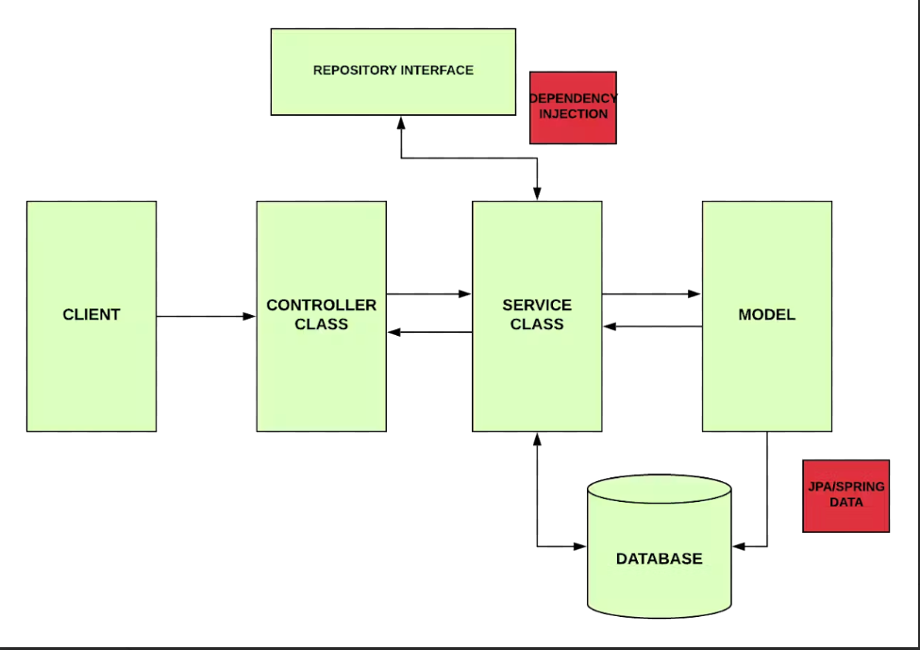
Architecture

Slide 5





Tools & Technology

Slide 6
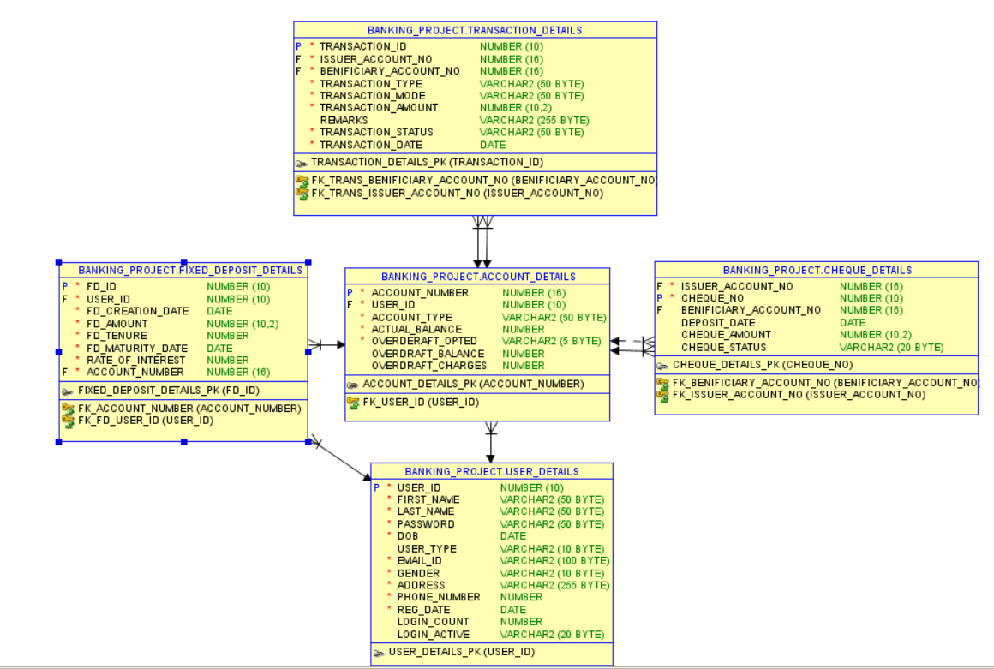
Database

Slide 7

Home Page

Slide 8
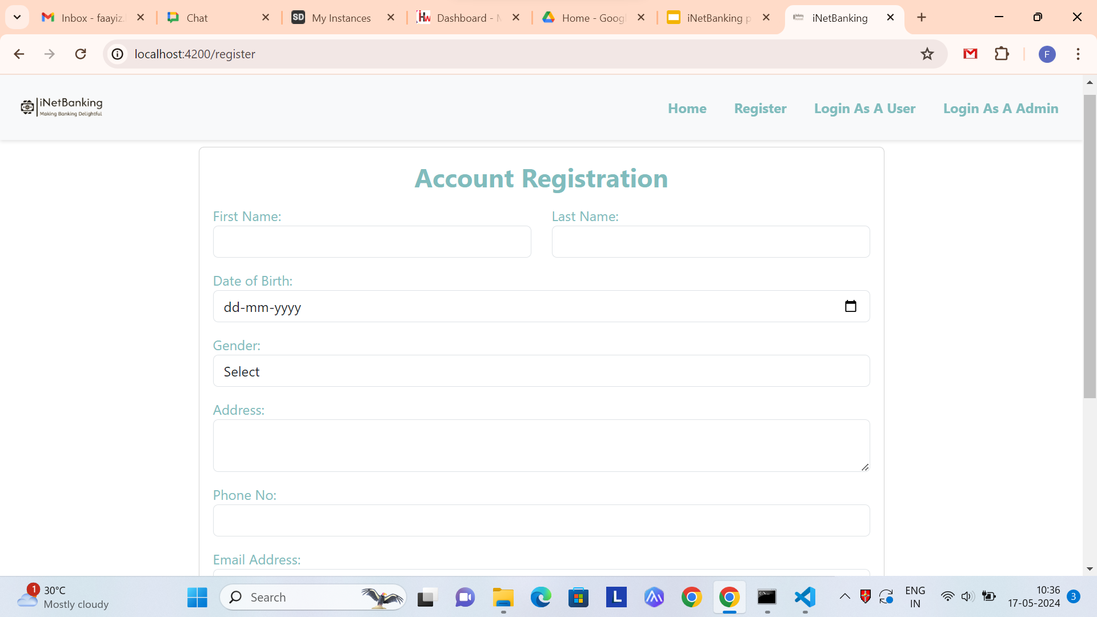

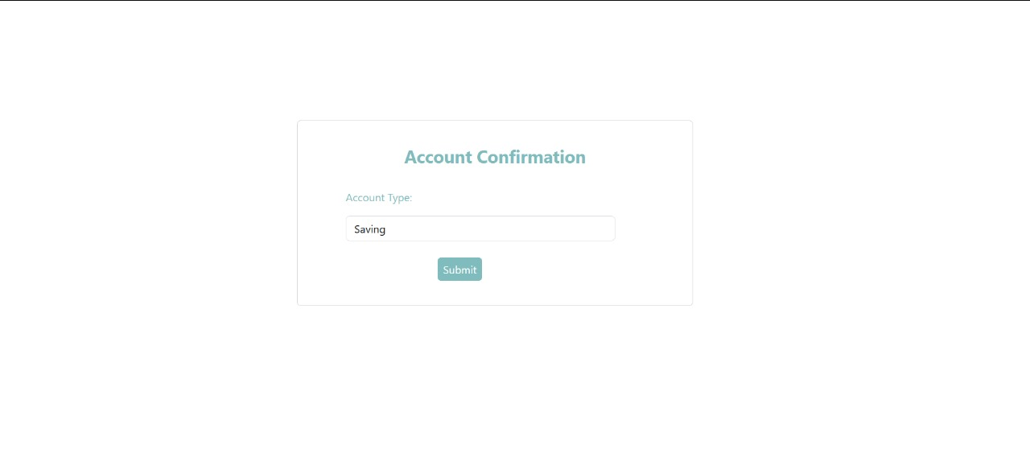
Registration

Slide 9


Login
User Login
Admin Login

Slide 10
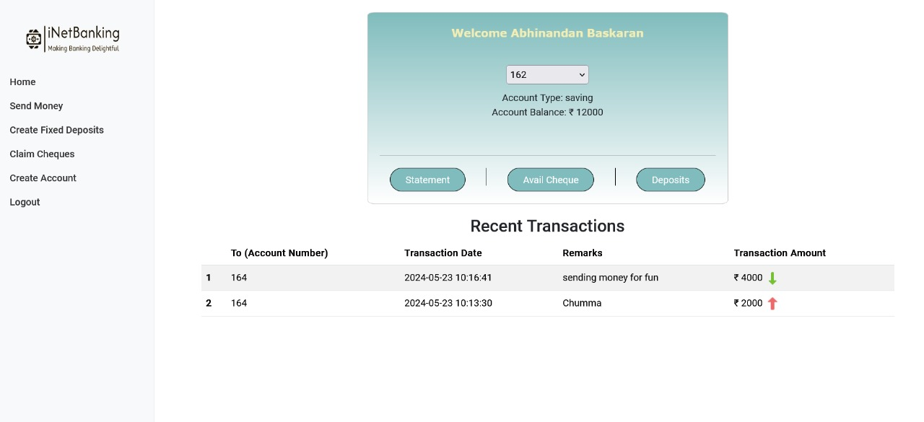
Dashboard

Slide 11
Conclusion
In conclusion, our banking application aim to empower individuals to take control of their finances online
We are grateful to Mr.Sanjit Jha for his valuable teaching and guidance which acts as a motivation to get along and complete our project

Slide 12
THANK YOU

